Slide 1
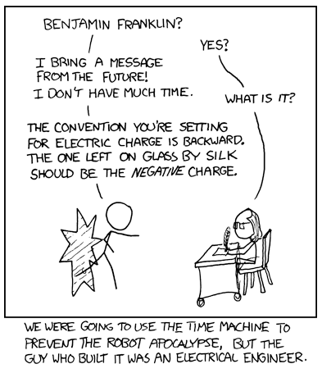

Slide 2
Exceptions
Zybooks 12
The complete Reference C++

Slide 3
Exception Basics
Error-checking code – code a programmer writes to detect and handle errors that occur during program execution
Exception – a circumstance that a program was not designed to handle
Negative numbers when Only positive numbers are needed
Alpha-numeric values when numeric was expected
Failure to create an object

Slide 4
Exception Basics
You have done this before:
If – else statements
Do While – loops
cin.good();
One more tool for your error handling code :
try{
…
//if error is detected
throw objectOfExceptionType;
…
}
catch (exceptionType excptObj){
// Handle Exception
}

Slide 5
Exception Basics
You have done this before:
If – else statements
Do While – loops
cin.good();
One more tool for your error handling code :
try{
…
//if error is detected
throw objectOfExceptionType;
…
}
catch (exceptionType excptObj){
// Handle Exception
}
Throw and Catch types must match.
Can use traditional C/C++ data types
(will match to the first catch type that matches)
Good Practice is to use classes from stdexception class

Slide 6
Exception Basics
You have done this before:
If – else statements
Do While – loops
cin.good();
One more tool for your error handling code :
try{
…
//if error is detected
throw objectOfExceptionType;
…
}
catch (exceptionType excptObj){
// Handle Exception
}
Try-catch statements allow for you to do error checking without cluttering your code with lots of if-else statements

Slide 7
Exception Basics
How try, throw, and catch work:
try{
…
//if error is detected
throw objectOfExceptionType;
…
}
catch (exceptionType excptObj){
// Handle Exception
}
…

Slide 8
Exception Basics
How try, throw, and catch work:
try{
…
//if error is detected
throw objectOfExceptionType;
…
}
catch (exceptionType excptObj){
// Handle Exception
}
…
try block surrounds normal code, which is exited immediately after a throw statement executes

Slide 9
Exception Basics
How try, throw, and catch work:
try{
…
//if error is detected
throw objectOfExceptionType;
…
}
catch (exceptionType excptObj){
// Handle Exception
}
…
Inside try, code executes normally …

Slide 10
Exception Basics
How try, throw, and catch work:
try{
…
//if error is detected
throw objectOfExceptionType;
…
}
catch (exceptionType excptObj){
// Handle Exception
}
…
Some conditional code executes. If an error condition exists…

Slide 11
Exception Basics
How try, throw, and catch work:
try{
…
//if error is detected
throw objectOfExceptionType;
…
}
catch (exceptionType excptObj){
// Handle Exception
}
…
A throw statement is executed and jumps immediately to the end of the try block.
The throw statement provides an object of a type defined in stdexcept library

Slide 12
Exception Basics
How try, throw, and catch work:
try{
…
//if error is detected
throw objectOfExceptionType;
…
}
catch (exceptionType excptObj){
// Handle Exception
}
…
A throw statement is executed and jumps immediately to the end of the try block

Slide 13
Exception Basics
How try, throw, and catch work:
try{
…
//if error is detected
throw objectOfExceptionType;
…
}
catch (exceptionType excptObj){
// Handle Exception
}
…
catch block IMMEDIATELY follows a try block.
If the catch is reached due to an exception, the catch block runs.
Catch block is also known as a handler

Slide 14
Exception Basics
How try, throw, and catch work:
try{
…
//if error is detected
throw objectOfExceptionType;
…
}
catch (exceptionType excptObj){
// Handle Exception
}
…
catch block IMMEDIATELY follows a try block.
If the catch is reached due to an exception, the catch block runs.
Catch block is also known as a handler

Slide 15
Exception Basics
How try, throw, and catch work:
try{
…
//if error is detected
throw objectOfExceptionType;
…
}
catch (exceptionType excptObj){
// Handle Exception
}
…
Continues to the end of the handler

Slide 16
Exception Basics
How try, throw, and catch work:
try{
…
//if error is detected
throw objectOfExceptionType;
…
}
catch (exceptionType excptObj){
// Handle Exception
}
…
Executes the rest of the code

Slide 17
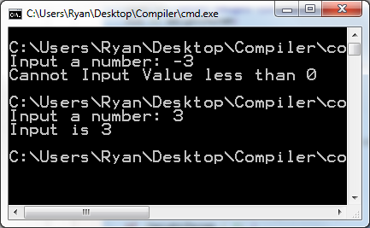
Exception Basics
Example: include <stdexception>
int input;
try{
cout << "Input a number: ";
cin >> input;
if(input <0)
throw runtime_error("Invalid Value for input");
cout << "Input is " << input << endl;
}
catch(runtime_error &excpt){
cout << "Cannot Input Value less than 0"<<endl;
}

Slide 18
Exception Basics
Try-Catch statements do not only work with just Exception Class types. Can also work with Integers, Doubles, Floats, Booleans, Characters, Character Strings, User Defined Classes, Derived Classes, …
If you do use Exception Class types, error messages can be called by the .what() function
runtime_error(“Error Message”) ←→ errorObj.what()

Slide 19
Exception Basics
Try-Catch statements do not only work with just Exception Class types. Can also work with Integers, Doubles, Floats, Booleans, Characters, Character Strings, User Defined Classes, Derived Classes, …
If you do use Exception Class types, error messages can be called by the .what() function
runtime_error(“Error Message”) ←→ errorObj.what()

Slide 20
Exceptions with Functions
The power of exceptions becomes clearer when used with a function.
When an exception is thrown from a function, it exits the function immediately and looks for a handler in the calling function.
NOTE: Every throw needs a catch! In Main, if the catch does not IMMEDIATELY follow the try block, an error occurs. There is more leeway if the throw is coming from a function call.

Slide 21
Exceptions with Functions
Keep in mind, when you throw an exception from a function, you technically do not need a catch within the function. However, because that function is nested inside a try block, the handle must be attached to that try block or else there is an error

Slide 22
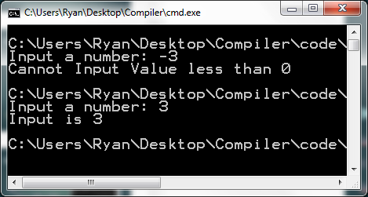
Exceptions with Functions
Small Example
int fxn()
{
int input;
cout << "Input a number: ";
cin >> input;
if(input <0){
throw runtime_error("Invalid Value for input");
}
return input;
}
int main()
{
int input;
try{
input = fxn();
cout << "Input is " << input << endl;
}
catch(runtime_error &excpt)
{
cout << "Cannot Input Value less than 0"<<endl;
}
return 0;
}

Slide 23
Exceptions – Multiple Handlers
You can throw different exceptions from one try block.
Multiple Handlers may exist, BUT, each handles a different data type
If there are two catches with the same data type, the code will only run on the first one

Slide 24
Exceptions – Multiple Handlers
How it is setup
try{
…
throw errorType1;
throw errorType2;
throw errorType3;
…
}
catch(errorType1 variable1){…}
catch(errorType2 variable2){…}
catch(errorType3 variable3){…}
…

Slide 25
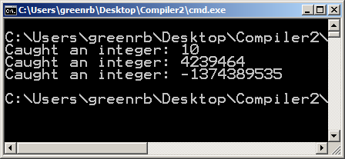
Exceptions – Multiple Handlers
MinGW
Example
#include <iostream>
using namespace std;
int main()
{
for(int i = 0; i < 3; i++){
try{
if(i == 0){ throw 10;}
if(i == 1){ throw "a";}
if(i == 2){ throw 2.36;}
}
catch(int i){cout << "Caught an integer: " << i <<endl; }
catch(double d){cout << "Caught a double: " << d <<endl;}
catch(char a){cout << "Caught a char: "<< a << endl;}
}
return 0;
}

Slide 26
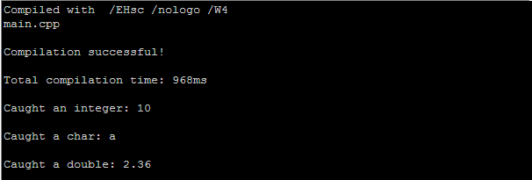
Exceptions – Multiple Handlers
http://webcompiler.cloudapp.net/
Example
#include <iostream>
using namespace std;
int main()
{
for(int i = 0; i < 3; i++){
try{
if(i == 0){ throw 10;}
if(i == 1){ throw "a";}
if(i == 2){ throw 2.36;}
}
catch(int i){cout << "Caught an integer: " << i <<endl; }
catch(double d){cout << "Caught a double: " << d <<endl;}
catch(char a){cout << "Caught a char: "<< a << endl;}
}
return 0;
}

Slide 27
Exceptions – Multiple Headers
A thrown exception may also be caught by a handler meant to catch an exception for a base class.
Common Error – place a catch block to handle a base class before catch blocks to handle derived classes.
Derived Classes will go with the catch associated with either Base or Derived Classes (which ever it gets to first)
Base Classes will only go with catch associated with the Base class.

Slide 28
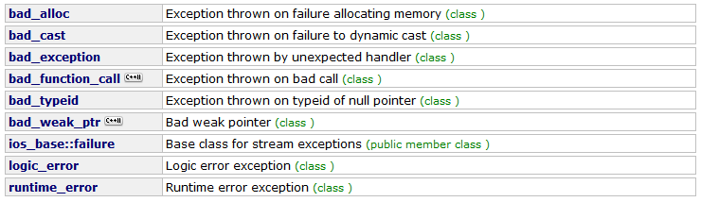
Exceptions – Multiple Headers
Various styles of errors present in <exception> and <stdexception>

Slide 29
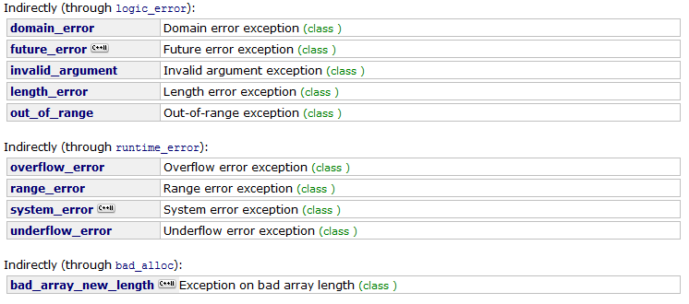
Exceptions – Multiple Headers
Various styles of errors present in <exception> and <stdexception>

Slide 30
Exceptions – Questions Select the one code region that is incorrect
try{
if (weight < 0)
try runtime_error(“Invalid Weight.”);
}
catch (runtime_error& excpt){
cout << excpt.what() << endl;
cout << “Cannot Compute Health Info.” <<endl;
}

Slide 31
Exceptions – Questions Select the one code region that is incorrect
try{
if (weight < 0)
try runtime_error(“Invalid Weight.”);
}
catch (runtime_error& excpt){
cout << excpt.what() << endl;
cout << “Cannot Compute Health Info.” <<endl;
}
Should be throw

Slide 32
Exceptions – Questions Select the one code region that is incorrect
try{
if (weight < 0)
throw runtime_error(“Invalid Weight.”);
}
catch (runtime_error& excpt){
cout << excpt() << endl;
cout << “Cannot Compute Health Info.” <<endl;
}

Slide 33
Exceptions – Questions Select the one code region that is incorrect
try{
if (weight < 0)
throw runtime_error(“Invalid Weight.”);
}
catch (runtime_error& excpt){
cout << excpt() << endl;
cout << “Cannot Compute Health Info.” <<endl;
}
Should be excpt.what()

Slide 34
Exception – Questions True or False
After an exception is thrown and a catch block executes, execution resumes after the throw statement

Slide 35
Exception – Questions True or False
After an exception is thrown and a catch block executes, execution resumes after the throw statement
FALSE

Slide 36
Exception – Questions True or False
A compiler generates an error message if a try block is not immediately followed by a catch block

Slide 37
Exception – Questions True or False
A compiler generates an error message if a try block is not immediately followed by a catch block
TRUE

Slide 38
Exception – Questions True or False
If no throw is executed in a try block, then the subsequent catch block is not executed

Slide 39
Exception – Questions True or False
If no throw is executed in a try block, then the subsequent catch block is not executed
TRUE

Slide 40
Exception – Questions True or False
For a function that may contain a throw, the function’s statements must be surrounded by a try block

Slide 41
Exception – Questions True or False
For a function that may contain a throw, the function’s statements must be surrounded by a try block
FALSE
The throw causes automatic exiting of the function. The calling code is then checked for a try/catch block until the exception is caught or main() is exited.

Slide 42
Exception – Questions True or False
A throw executed in a function automatically causes a jump to the last return statement in the function

Slide 43
Exception – Questions True or False
A throw executed in a function automatically causes a jump to the last return statement in the function
FALSE
The throw causes immediate jump to the catch block, or immediate exit to the caller

Slide 44
Exception – Questions True or False
A goal of exception handling is to avoid polluting the normal code with distracting error-handling code.

Slide 45
Exception – Questions True or False
A goal of exception handling is to avoid polluting the normal code with distracting error-handling code.
TRUE

Slide 46
Exception – Questions True or False
try{
…
throw objOfExcptType1;
…
throw objOfExcptType2;
…
throw objOfExcptType3;
…
}
catch(exptType1& obj){
…}
catch(exptType2& obj){
…}
catch(exptType3& obj){
…}
If an object of type ExcptType1 is thrown, three catch blocks will execute.

Slide 47
Exception – Questions True or False
try{
…
throw objOfExcptType1;
…
throw objOfExcptType2;
…
throw objOfExcptType3;
…
}
catch(exptType1& obj){
…}
catch(exptType2& obj){
…}
catch(exptType3& obj){
…}
If an object of type ExcptType1 is thrown, three catch blocks will execute.
FALSE

Slide 48
Exception – Questions True or False
try{
…
throw objOfExcptType1;
…
throw objOfExcptType2;
…
throw objOfExcptType3;
…
}
catch(exptType1& obj){
…}
catch(exptType2& obj){
…}
catch(exptType3& obj){
…}
If an object of type ExcptType3 is thrown, no catch block will execute.

Slide 49
Exception – Questions True or False
try{
…
throw objOfExcptType1;
…
throw objOfExcptType2;
…
throw objOfExcptType3;
…
}
catch(exptType1& obj){
…}
catch(exptType2& obj){
…}
catch(exptType3& obj){
…}
If an object of type ExcptType3 is thrown, no catch block will execute.
FALSE

Slide 50
Exception – Questions True or False
try{
…
throw objOfExcptType1;
…
throw objOfExcptType2;
…
throw objOfExcptType3;
…
}
catch(exptType1& obj){
…}
catch(exptType2& obj){
…}
catch(exptType3& obj){
…}
A second catch block can never execute immediately after a first one executes

Slide 51
Exception – Questions True or False
try{
…
throw objOfExcptType1;
…
throw objOfExcptType2;
…
throw objOfExcptType3;
…
}
catch(exptType1& obj){
…}
catch(exptType2& obj){
…}
catch(exptType3& obj){
…}
A second catch block can never execute immediately after a first one executes
TRUE

Slide 52
Exception – Questions True or False
try{
…
throw objOfExcptType1;
…
throw objOfExcptType2;
…
throw objOfExcptType3;
…
}
catch(exptType1& obj){
…}
catch(exptType2& obj){
…}
catch(exptType3& obj){
…}
If excptType2 inherits from excptType1, then the second catch block will never be executed

Slide 53
Exception – Questions True or False
try{
…
throw objOfExcptType1;
…
throw objOfExcptType2;
…
throw objOfExcptType3;
…
}
catch(exptType1& obj){
…}
catch(exptType2& obj){
…}
catch(exptType3& obj){
…}
If excptType2 inherits from excptType1, then the second catch block will never be executed
TRUE

